Slide 1

Cloud Rangers

Slide 2



Pain point
Surprises in energy bills?
Worried about the world we will leave behind?

Slide 3
Our vision
A service
That empower users to make informed decisions
Reducing energy costs
And promoting the use of clean, renewable energy sources

Slide 4
Implementation
User can track its energy consumption.
Provide real-time data of energy pool predictions
Propose more efficient appliances from BSH catalog

Slide 5

Solving the problem
Creates awareness of user habits
Easy to use
Cheap

Slide 6
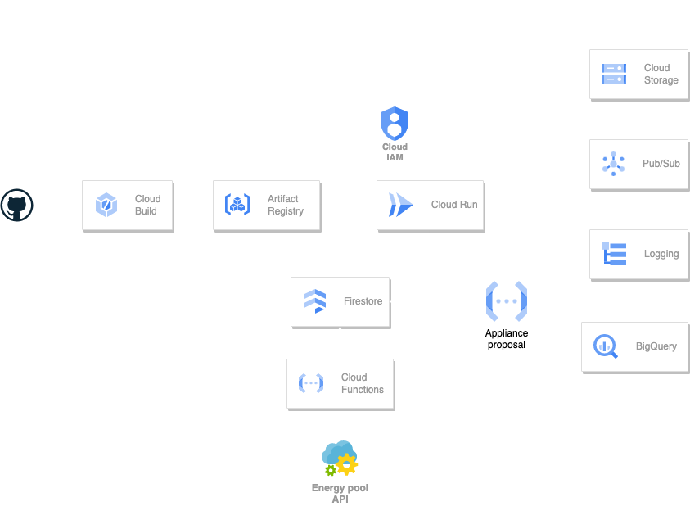

Slide 7
Costs
Per 10.000 users intensive use month
Firestore: $0.06/100.000 documents
Cloud Run: $0.000024 vCPU/s & $0.0000026 GiB/s
Cloud Storage: $0.02/GB
Pub/sub: $0.4/GB
Logging: $0.1/GB
BigQuery: $0.02/GB month
Firestore: 2€
Cloud Run: €100
Cloud Storage: 15€
Pub/sub: <1€
Logging: <1€
BigQuery: 15€
130€/month

Slide 8
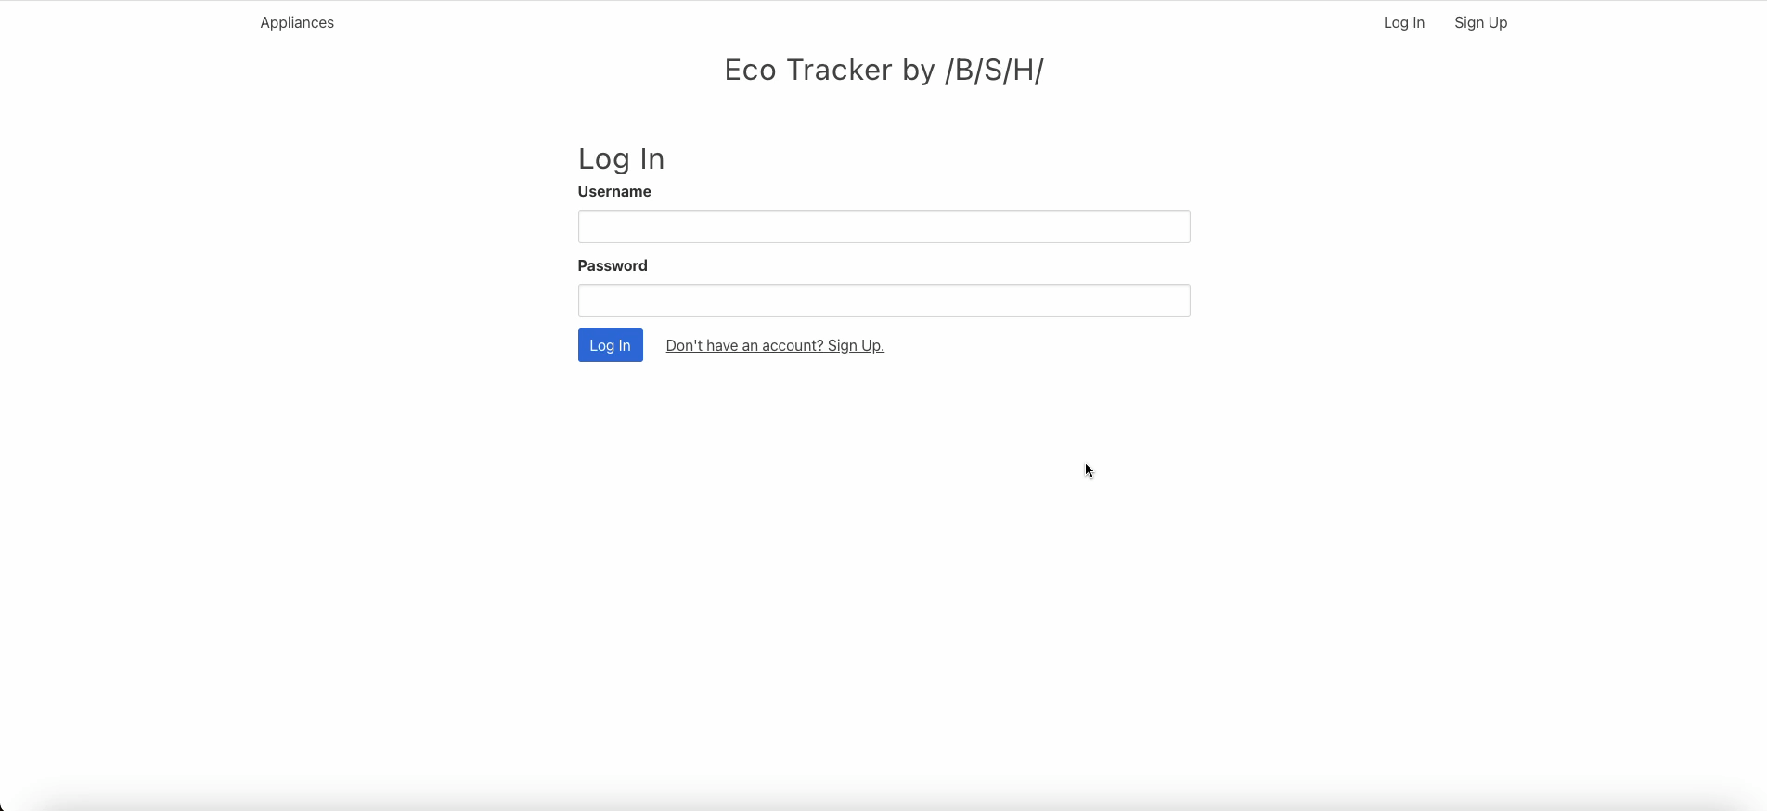
Demo
Eco Tracker by /B/S/H/

Slide 9

Competitiveness & Impact
Behavior change
Consciousness rise
Cost savings
Boost industry efficiency solutions

Slide 10








Nikhil
The CI/CD Comedian
Automation
Priyesh
Security Ninja
Encrypt absolutely everything
Mykola
Generate infinite loops
Avoid disaster
Jorge
Test and break everything
Don‘t break anything

